Slide 1
Computational Physics
(Lecture 12)
PHY4061

Slide 2
Kinetic Monte Carlo
Intended to simulate the time evolution of some processes occurring in nature.
Predetermined or known rate of the processes.
Used widely in
  Surface diffusion. Surface growth. Defects diffusion. Coarsening of domain evolution….

Slide 3
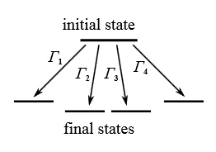


Slide 4
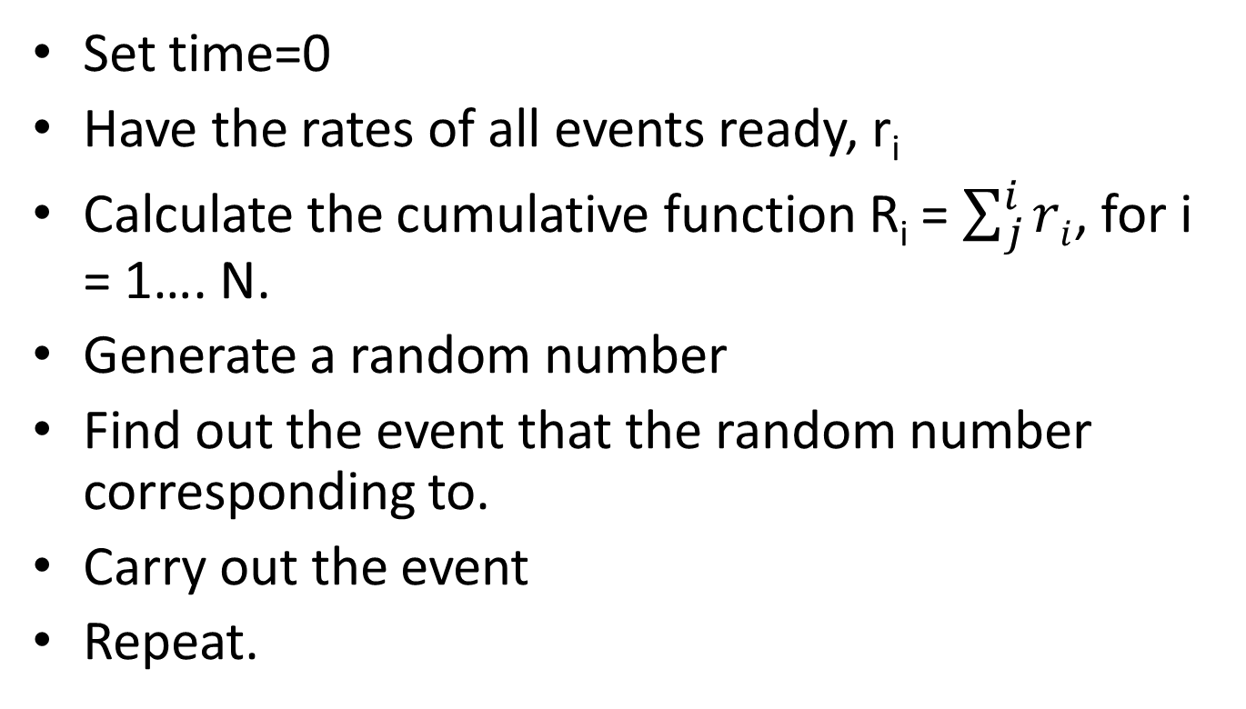
Algorithm
Set time=0
Have the rates of all events ready, r_{i}
Calculate the cumulative function R_{i} = $\sum_{j}^{i}{ri}$, for i = 1…. N.
Generate a random number
Find out the event that the random number corresponding to.
Carry out the event
Repeat.

Slide 5
Note, it’s also possible to treat the simulation step non-uniformly by generating another random number, and the delta t = ln(1/rand)/ R_N.
Events generation rates can also be time dependent.
Good to simulate non-equilibrium process.

Slide 6
To simulate surface diffusions
Define Γ as the hopping rate, γ is the vibrational frequency, Ed is the diffusion barrier
Γ = γ exp(-Ed/k_{B} T)
So if you know γ, T, and Ed, the diffusion can be simulated using a random number generator.

Slide 7
Iterative function system
MC is also used in fractal studies.
Method to construct fractals.
For example:
  We have three points A, B, C (not on the same line) and three probabilities, PA, PB and PC.
  Throw the dice, generate a point Z, following:
  Z_{n+1} = (Z_{n} + A )/2, under PA, (Z_{n} + B)/2, under PB, (Z_{n} + C)/2, under PC.

Slide 8
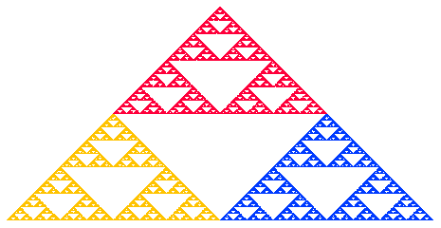

Slide 9
Randomly choose which point to plot.
Good to simulate biological systems.

Slide 10
Monte Carlo in Finance
Risk Neutral measure
Instead of first taking the expectation and then adjusting for an investor's risk preference,
one can adjust, once and for all, the probabilities of future outcomes
such that they incorporate all investors' risk premia, and then take the expectation under this new probability distribution, the risk-neutral measure.

Slide 11
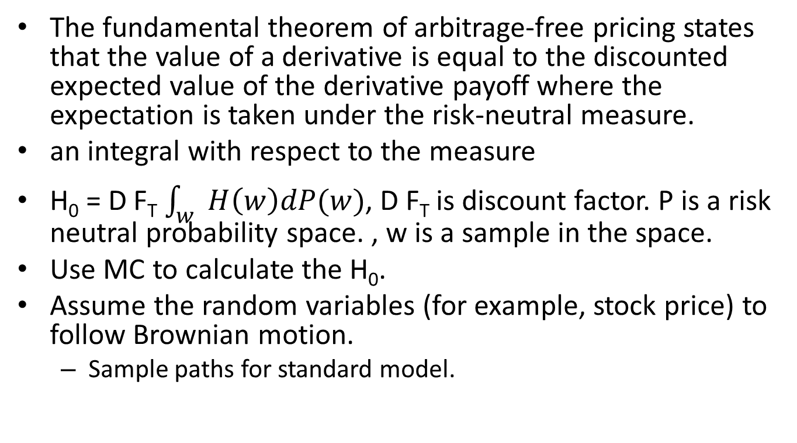
Monte Carlo in Finance
The fundamental theorem of arbitrage-free pricing states that the value of a derivative is equal to the discounted expected value of the derivative payoff where the expectation is taken under the risk-neutral measure.
an integral with respect to the measure
H₀ = D F_{T} $\int_{w}{H\left(w\right)dP(w)}$, D F_{T} is discount factor. P is a risk neutral probability space. , w is a sample in the space.
Use MC to calculate the H₀.
Assume the random variables (for example, stock price) to follow Brownian motion.
  Sample paths for standard model.

Slide 12
Project A part 4
Write a subroutine of Steepest Decent and Conjugate Gradient method for minimization of total energy. Test these methods by randomly displacing atoms (very small displacements) in LJ (50%) based crystal and the crystal structure of your choice in part 4, and then relaxing the atoms to their equilibrium positions. Plot the starting and the ending positions of your crystal structures using VMD. You may get 10% bonus if you implement CG in SW/Tersoff or EAM potentials, but your total score is capped at 100%

Slide 13
Ordinary differentiation equation
Most problems in physics and engineering appear in the form of differential equations.
  the motion of a classical particle is described by Newton’s equation

Slide 14
Initial-value problems
initial-value problems involve dynamical systems,
  for example, the motion of the Moon, Earth, and the Sun,
  the dynamics of a rocket, or the propagation of ocean waves.

Slide 15
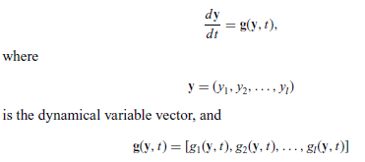
Generalized velocity vector.

Slide 16
In principle, we can always obtain the solution of the above equation set if the initial condition y(t = 0) = y₀ is given and a solution
exists.

Slide 17
the particle moving in one dimension under an elastic force:
  f = ma,
i = 2: that is, y₁ = x and y₂ = v = dx/dt,
and g₁ = v = y₂
and g₂= f/m = −kx/m = −ky₁/m.
dy₁/dt = y₂,
dy₂/dt= −k y₁/m
If y₁(0) and y₂(0) are given, we can solve it numerically.

Slide 18
Most high order differential equations can be transformed into a set of coupled first-order differential equations.
The higher order derivatives are usually redefined into new dynamical variables during the transformation.

Slide 19
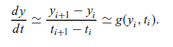
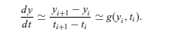
The Euler and Picard methods
Numerically, we can rewrite the velocity as:
Here, i is the ith time step.
Let g_{i} = g(y_{i}, t_{i}), τ=t_{i+1} – t_{i}, then we have: (the Euler Method)

Slide 20
Problem of the Euler method:
  Low accuracy
  The error accumulates!
We just can’t apply this method to most problems.

Slide 21
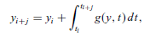
Rewrite the equation:
If we can integrate the second part, we will get the exact solution.

Slide 22
We cannot obtain the integral in general.
Approximation is important.

Slide 23
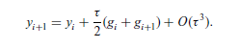
The Picard method
Adaptive scheme
each iteration carried out by using the solution from the previous iteration as the input on the right-hand side
For example, if we choose j = 1 and use the trapezoid rule for the integral, we obtain the algorithm

Slide 24
Problem of the Picard method
Problem: Can be very slow. May have convergence problem if the initial guess is not close to the actual solution.
Any suggestions on how to improve this method?

Slide 25
Predictor--corrector methods
apply a less accurate algorithm to predict the next value y_{i+1} first.
  for example, using the Euler algorithm and then apply a better algorithm to improve the new value (Picard algorithm).

Slide 26
// A program to study the motion of a particle under an
// elastic force in one dimension through the simplest
// predictor-corrector scheme.
import java.lang.*;
public class Motion2 {
static final int n = 100, j = 5;
public static void main(String argv[]) {
double x[] = new double[n+1];
double v[] = new double[n+1];
// Assign time step and initial position and velocity
double dt = 2*Math.PI/n;
x[0] = 0;
v[0] = 1;
// Calculate other position and velocity recursively
for (int i=0; i<n; ++i) {
// Predict the next position and velocity
x[i+1] = x[i]+v[i]*dt;
v[i+1] = v[i]-x[i]*dt;
// Correct the new position and velocity
x[i+1] = x[i]+(v[i]+v[i+1])*dt/2;
v[i+1] = v[i]-(x[i]+x[i+1])*dt/2;
}
// Output the result in every j time steps
double t = 0;
double jdt = j*dt;
for (int i=0; i<=n; i+=j) {
System.out.println(t +" " + x[i] +" " + v[i]);
t += jdt;
}
}
}

Slide 27
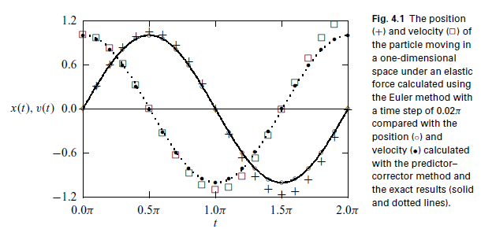

Slide 28
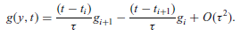
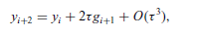
Another way to improve an algorithm is by increasing the number of mesh points j.
  Thus we can apply a better quadrature to the integral.
  For example, if we take j = 2, and then use the linear interpolation scheme to approximate g(y, t) in the integral from g_{i} and g_{i+1},

Slide 29
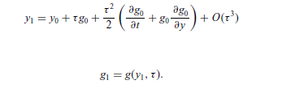
One order of magnitude better than Euler.
need the values of the first two points in order to start this algorithm.
can be obtained by the Taylor expansion around the initial point at t = 0.
Can we include more points and achieve higher accuracies?

Slide 30
we can always include more points in the integral to obtain a higher accuracy
  we will need the values of more points to start the algorithm!
  impractical if we need more than two points in order to start the algorithm.
  the errors accumulated from the approximations of the first few points will eliminate the apparently high accuracy of the algorithm!

Slide 31
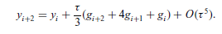
We can make the accuracy even higher by using a better quadrature.
For example, we can take j = 2 and apply the Simpson rule to the integral.
We can use this one as the corrector and the algorithm of O(τ³) as the predictor.

Slide 32
One simple model a motorcycle jump over a gap:
The air resistance on a moving object is roughly given by f_{r}=-κvv = −cAρvv, where A is cross section of the moving object, ρ is the density of the air, and c is a coefficient that accounts for all the other factors on the order
of 1.

Slide 33
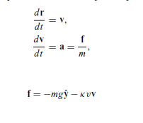

Slide 34
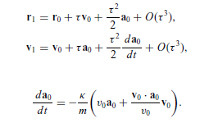
Assuming that we have the first point given, that is, r₀ and v₀ at t = 0,
the next point is then obtained from the Taylor expansions and the equation set with

Slide 35
// An example of modeling a motorcycle jump with the
// two-point predictor-corrector scheme.
import java.lang.*;
public class Jump {
static final int n = 100, j = 2;
public static void main(String argv[]) {
double x[] = new double[n+1];
double y[] = new double[n+1];
double vx[] = new double[n+1];
double vy[] = new double[n+1];
double ax[] = new double[n+1];
double ay[] = new double[n+1];
// Assign all the constants involved
double g = 9.80;
double angle = 42.5*Math.PI/180;
double speed = 67;
double mass = 250;
double area = 0.93;
double density = 1.2;
double k = area*density/(2*mass);
double dt = 2*speed*Math.sin(angle)/(g*n);
double d = dt*dt/2;
// Assign the quantities for the first two points
x[0] = y[0] = 0;
vx[0] = speed*Math.cos(angle);
vy[0] = speed*Math.sin(angle);
double v = Math.sqrt(vx[0]*vx[0]+vy[0]*vy[0]);
ax[0] = -k*v*vx[0];
ay[0] = -g-k*v*vy[0];
double p = vx[0]*ax[0]+vy[0]*ay[0];
x[1] = x[0]+dt*vx[0]+d*ax[0];
y[1] = y[0]+dt*vy[0]+d*ay[0];
vx[1] = vx[0]+dt*ax[0]-d*k*(v*ax[0]+p*vx[0]/v);
vy[1] = vy[0]+dt*ay[0]-d*k*(v*ay[0]+p*vy[0]/v);
v = Math.sqrt(vx[1]*vx[1]+vy[1]*vy[1]);
ax[1] = -k*v*vx[1];
ay[1] = -g-k*v*vy[1];
// Calculate other position and velocity recursively
double d2 = 2*dt;
double d3 = dt/3;
for (int i=0; i<n-1; ++i) {

Slide 36
// Predict the next position and velocity
x[i+2] = x[i]+d2*vx[i+1];
y[i+2] = y[i]+d2*vy[i+1];
vx[i+2] = vx[i]+d2*ax[i+1];
vy[i+2] = vy[i]+d2*ay[i+1];
v = Math.sqrt(vx[i+2]*vx[i+2]+vy[i+2]*vy[i+2]);
ax[i+2] = -k*v*vx[i+2];
ay[i+2] = -g-k*v*vy[i+2];
// Correct the new position and velocity
x[i+2] = x[i]+d3*(vx[i+2]+4*vx[i+1]+vx[i]);
y[i+2] = y[i]+d3*(vy[i+2]+4*vy[i+1]+vy[i]);
vx[i+2] = vx[i]+d3*(ax[i+2]+4*ax[i+1]+ax[i]);
vy[i+2] = vy[i]+d3*(ay[i+2]+4*ay[i+1]+ay[i]);
}
// Output the result in every j time steps
for (int i=0; i<=n; i+=j)
System.out.println(x[i] +" " + y[i]);
}
}
we have used the cross section A = 0.93 m^2, the takingoff speed v0 = 67 m/s, the air density = 1.2 kg/m^3, the combined mass of the
motorcycle and the person 250 kg, and the coefficient c = 1.

Slide 37
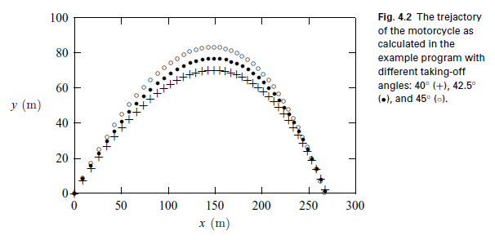

Slide 38
The Runge–Kutta method
A more practical method that requires only the first point in order to start or to improve the algorithm is the Runge–Kutta method, which is derived from two different Taylor expansions of the dynamical variables and their derivatives.
For details, please read the textbook.

